Slide 1
MATLAB and SIMULINK Robot Competition (2/22/16)
Sergei Bilardi
Erik Parker
Kari Slotten
(Eliza Gazda)

Slide 2
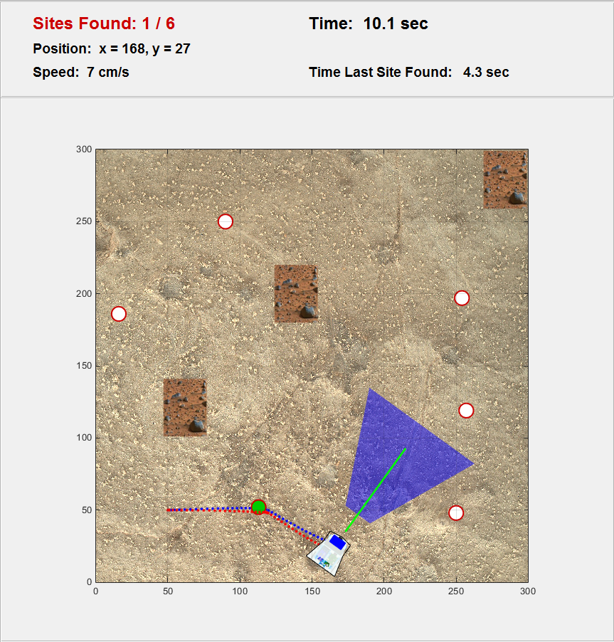
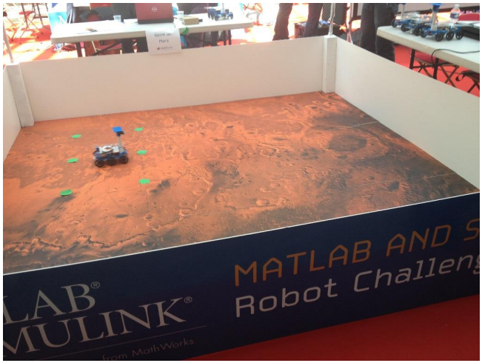
Competition Objective
Find the greatest number green dots (6 total) in the shortest period of time.
Preference goes to highest number, then the fastest time.
Stop at each green dot for 3 seconds
Each green dot represents an area of scientific interest
Must avoid obstacles

Slide 3
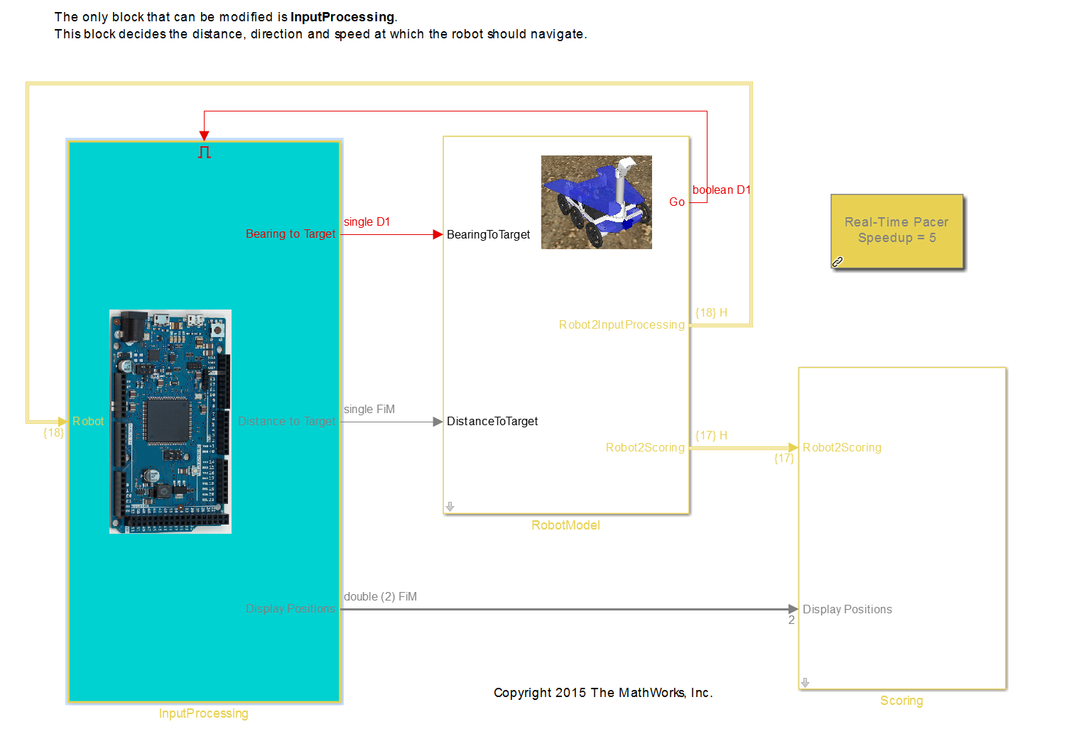
Programming the Rover

Slide 4
WHAT WE HAVE CONTROL OVER
CHALLENGES
Wheels slip
Layout of obstacles and areas of interest will be random
WHAT WE CAN’T CONTROL
Avoidance maneuvers
Motor spin rate
Response to area of interest
Sensors
Object detection

Slide 5
First Observations
Control acceleration to limit wheels slippage
Maintain a map of the environment and constantly recalibrate to avoid going to same dot twice.
brainstorming
Goes to the same place multiple times
Won’t go to a dot near a wall
Occasionally turns and hits back on wall

Slide 6
Some plans
Determine sensor output from
Distance sensor
Camera
Wheel encoders (measure distance covered by wheels)
Knowing what sensor data is returned will help to better plan the rover’s algorithms

Slide 7
What was done
Review of last year’s code and basic testing
Altered avoidance maneuvers
Registration of team
Waiting for response from MathWorks
Will be provided software and code

